Slide 1

File Encryptor In C++
BCE III Semester
Bachelor in Computer Engineering
Salim Shrestha (731744) | Sarswoti Rokaya (731763) | Aayush Kumar Mallik (731759) Supervisor: Mr. Kiran Khanal

Slide 2
Table of Content
Introduction
Objective
Features
Problem Statement
Methodology
Tools and Technologies
System Design
Diagrams
Testing & Results
Conclusion
Future Enhancements

Slide 3
Introduction
Encryption is the process of converting data into a secure format.
Used to ensure privacy and security during storage or transfer.
This project uses the Caesar Cipher algorithm in C++ to create a simple file encryptor with a graphical interface.

Slide 4
Objective
Confidentiality:
Protect data from unauthorized access
Data Integrity:
Prevent modification during storage or transfer
Access Control:
Restrict file access to key holders.
Secure Storage & Communication:

Slide 5
Features
Caesar Cipher-based encryption and decryption
GUI using WinBGIm (graphics.h)
File selection via dialog box
Loading animation and sound feedback
History log (history.txt)
Error handling and visual confirmation

Slide 6
Problem Statement
Many users lack access to simple encryption tools.
Existing solutions are often complex, paid, or require internet access.
This tool bridges that gap by offering a lightweight, offline, and beginner-friendly solution.

Slide 7
Methodology
Development Approach: Agile + Modular Prototyping
Sprints for: Cipher Logic → File I/O → GUI → Sound/History
Early console prototypes for logic validation
Peer feedback for usability

Slide 8
Tools & Technologies
C++ - Core language
Dev C++ / VS Code - Code editing and compiling
GCC / MSVC - Compilation
WinBGIm - GUI (graphics.h)
Windows API - File Dialogs, Sound playback

Slide 9
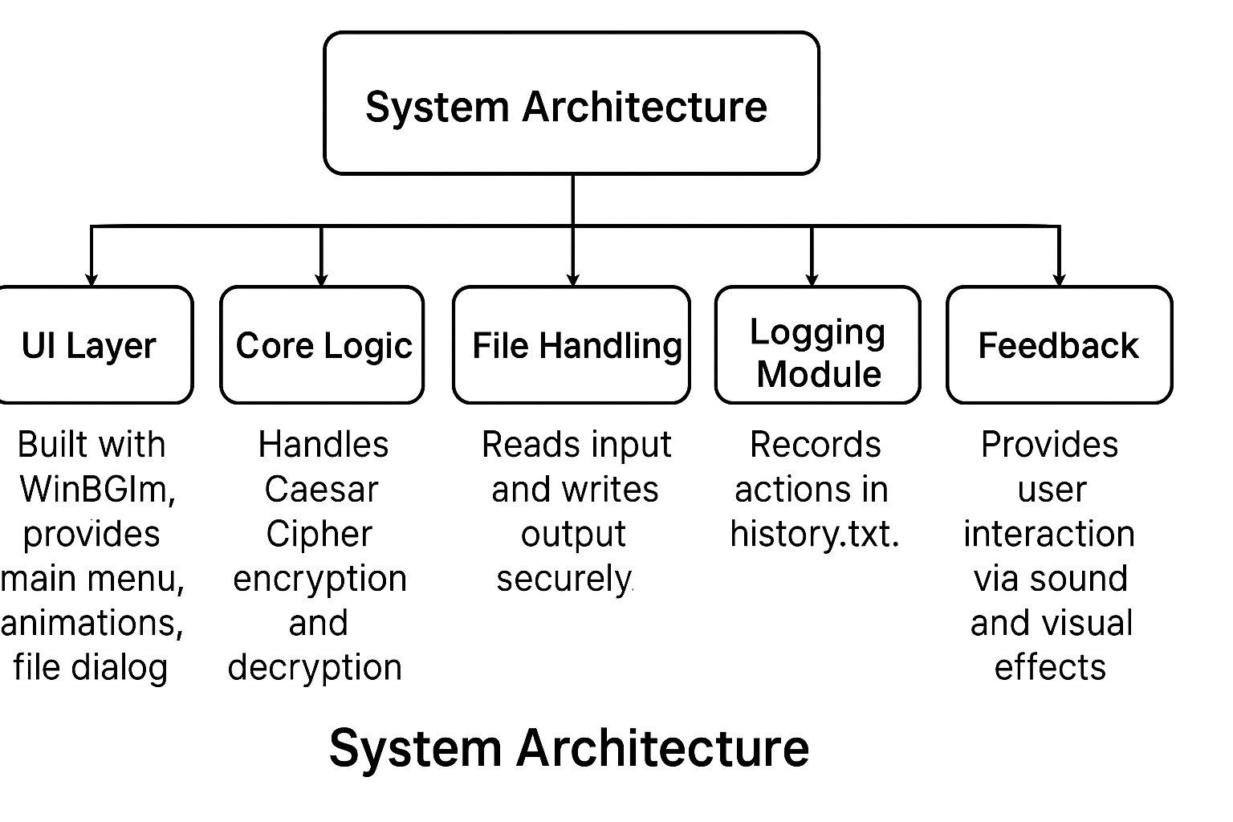
System Architecture
UI Layer:
Menu, Dialogs, Animation
Encryption Logic:
Caesar Cipher
File Handler:
Input/Output
Logger:
History tracking
Feedback:
Sounds and messages

Slide 10
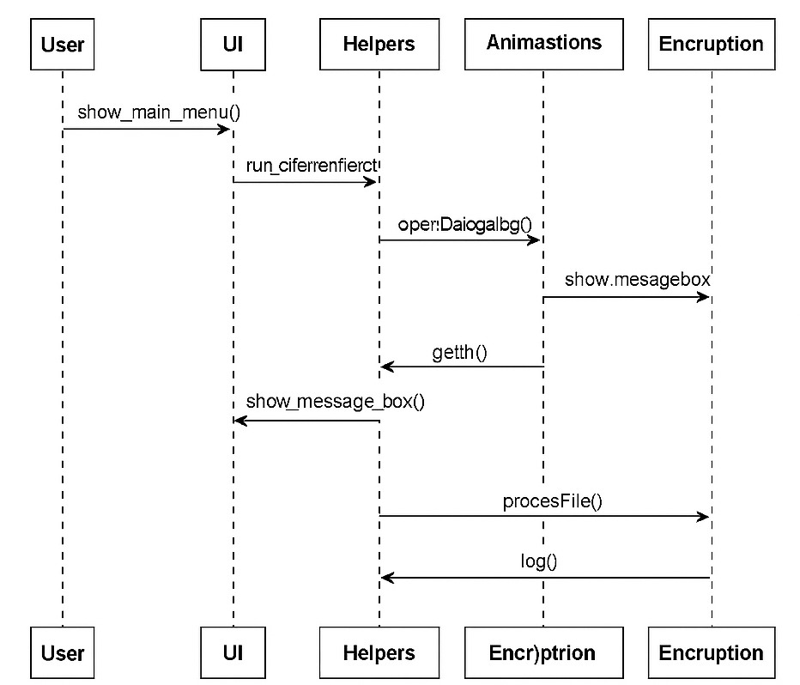
UML Diagrams
Flowchart: Encryption/Decryption process
Class Diagram: Core components
Use Case: User interaction with system
Activity / Sequence Diagrams
Fig: Sequence Diagram

Slide 11
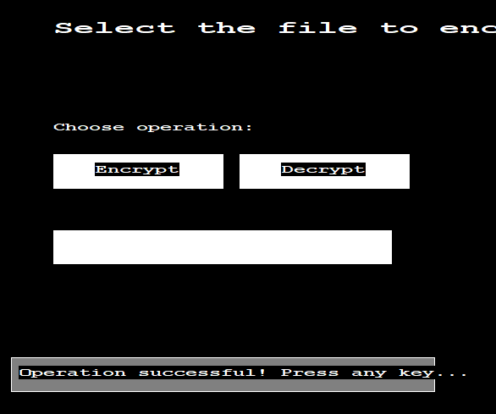
Testing & Debugging
Test Cases:
Encrypt & Decrypt valid file
Handle missing or invalid file
Display history
Debugging Focus:
UI region click calibration
Sound file path testing
Edge cases (empty/special character files)

Slide 12
Conclusion
Built a working file encryptor using Caesar Cipher in C++.
Demonstrated file I/O, GUI programming, and basic encryption.
Laid foundation for exploring advanced security techniques.

Slide 13
Future Enhancements
Add password-based encryption
Support multiple algorithms (AES, RSA)
Cross-platform GUI (Qt/GTK)
Key management and user profiles

Slide 14
Thank You
Questions? Feedback?
Presented by:
Salim Shrestha
Sarswoti Rokaya
Aayush Kumar Mallik

